Slide 1
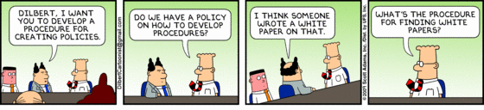
Policies & Procedures Creating a consistent customer experience
Macarthur Business Development Centre
9 April 2019

Slide 2
The company policy…
communicates the organisation’s underpinning principles and values
clarifies the expectations of employee behaviours and performance
sets out the consequences of non-compliance
may form part of the employment contract
is often provided to employees in a handbook
Policies help employers manage staff more effectively by defining what is and isn’t acceptable in the workplace.

Slide 3
What’s in a policy?
A workplace policy should include:
its purpose – why the policy was developed
its scope - who the policy applies to
the required behaviour
the consequences of non-compliance
the date that the policy was developed or updated
Policies need to be reviewed on a regular basis and updated where necessary, eg changes in legislation, award, etc.

Slide 4
Examples of policies
Code of Conduct
Internet / Email / Social Media Policy
Mobile Phone Policy
Drug and Alcohol Policy
WH&S Policy
Vehicle Policy
Anti-Discrimination and Harassment Policy

Slide 5
The workplace procedure…
is a series of steps that, when followed in order, achieve a desired result
increases efficiency and effectiveness
enables routine tasks to be systemised, and more easily delegated
enables employees to learn new tasks more quickly
may be presented as a document, a checklist, a flow chart, a video
Documented procedures help employees deliver a consistent customer experience.

Slide 6
Tips on writing procedures
Consider the skills and experience of the target audience
Avoid too many words; just be specific enough to communicate clearly
Use bullets and lists where possible
Use jargon and slang carefully
Use active verbs, eg insert, create, add, select, etc
Include visuals, eg screenshots, photos and videos
Get someone else to test the procedure – they’ll find the missing bits!

Slide 7
Coffee anyone?
START
Boil kettle
Add coffee to cup
Add boiling water
Add milk
Add sugar
END

Slide 8
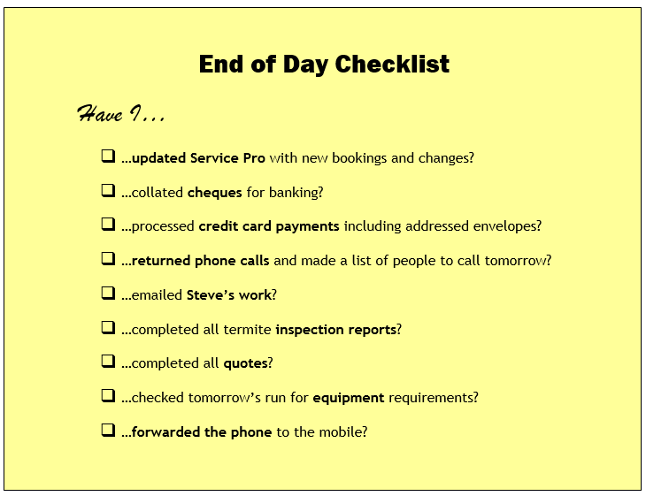

Slide 9
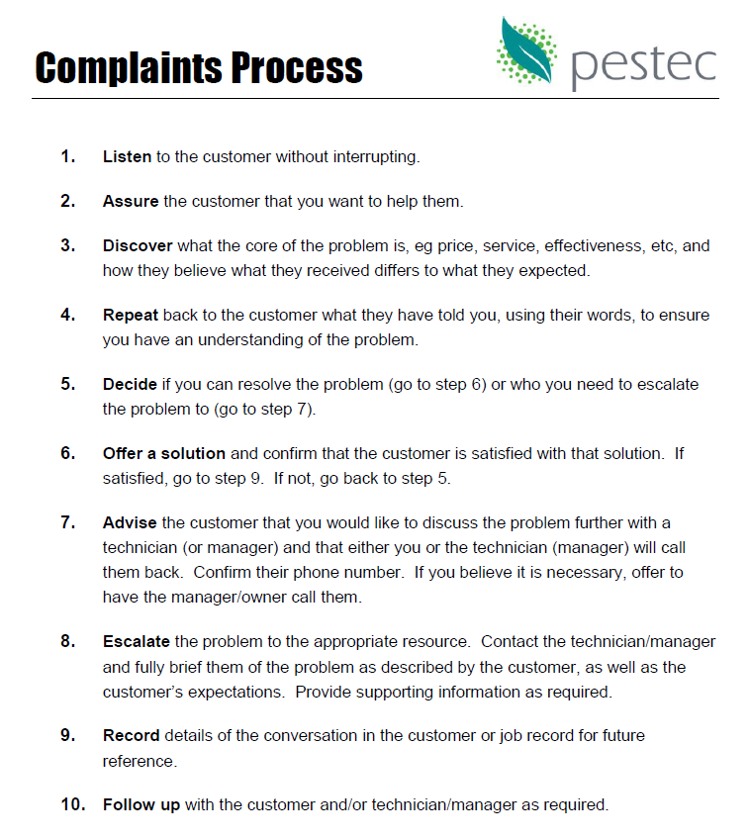

Slide 10
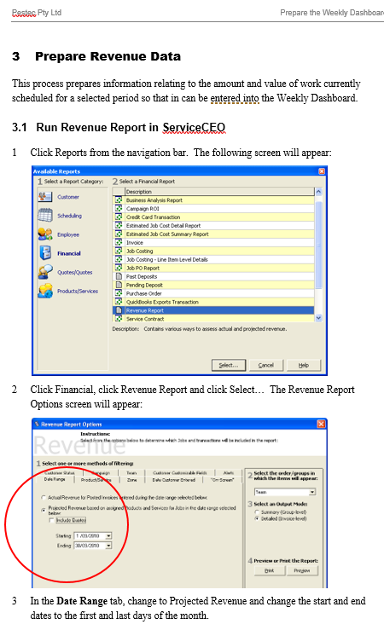

Slide 11
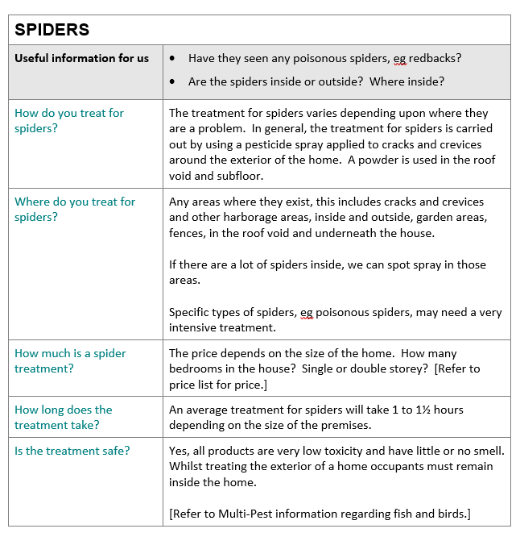

Slide 12
In summary…
Policies serve to communicate your organisation’s values and to establish boundaries, guidelines and best practices for acceptable behaviour from your employees.
Procedures provide a detailed breakdown of the steps required to complete a task and ensure a consistent and repetitive approach to achieve an end result.

Slide 13
How do they help me?
Procedures
Consistent
Team
Positive
Policies

Slide 14
Start with the end in mind…

Slide 15
Over to you…
What’s not working in your business?
What’s difficult to do consistently?
What do new staff always struggle with?
What do your customers complain about?
Pick one thing and commit to documenting a procedure for it in the next 72 hours!

